Slide 1
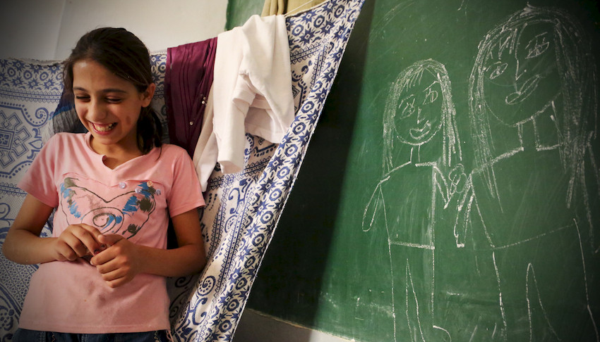
EDUCATION IN EMERGENCIES

Slide 2
WHAT IS EDUCATION IN EMERGENCIES (EiE)?
Emergencies Disruption to learning and development
Making sure children and young people learn and continue their education

Slide 3
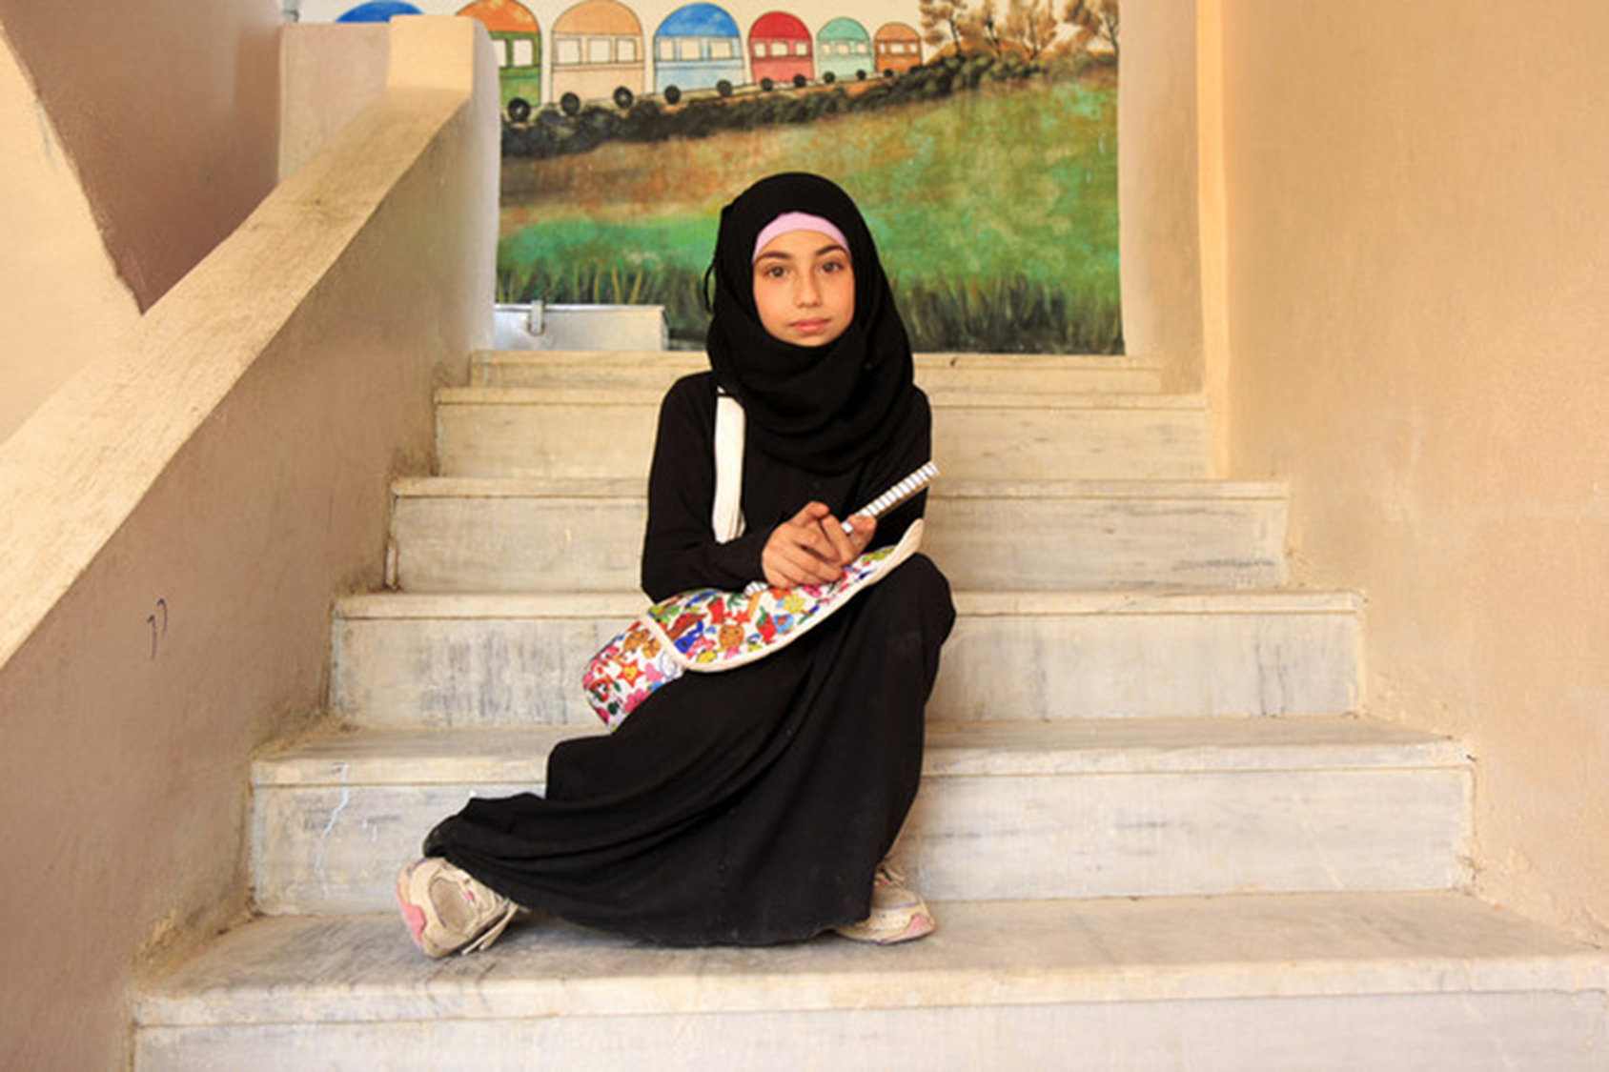
WHY EDUCATION?
Education is a right
Education is prioritised by communities
Education is critical for healthy development and future life opportunities
Quality education and learning spaces is a form of protection
Education is a platform for other interventions

Slide 4
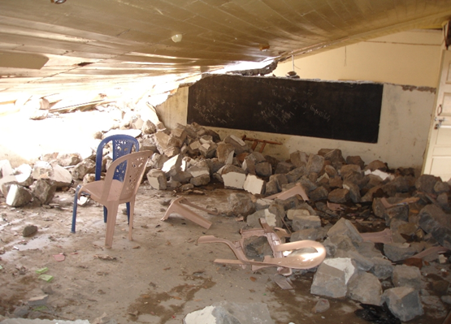
IMPACT ON SCHOOLS
Damaged or destroyed
Materials damaged, destroyed or looted
Targeted by armed groups
Not enough classrooms for number of students
Route to school unsafe
Not safe – close to conflict, or natural disaster

Slide 5
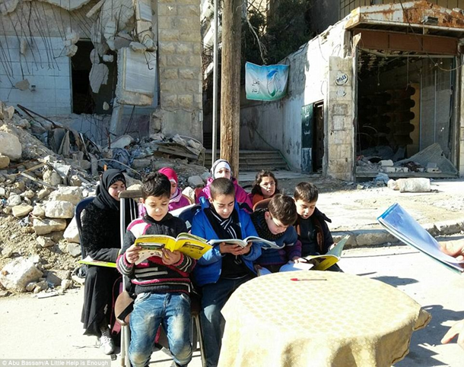
IMPACT ON STUDENTS
Schoolbooks and uniform lost or damaged
Drops out of school
Displaced
Wellbeing affected – stress, distress, fear, trauma
Loss of learning opportunities
Loss of routine or normalcy
Injured
Afraid of going to school due to conflict or disaster
Misses months or years of education – impact on wellbeing, development and future livelihoods
Lost family or community
Notes:
Example of how teachers, students and communities often try and continue education in extreme circumstances and with limited resources. This photo is from Aleppo.

Slide 6
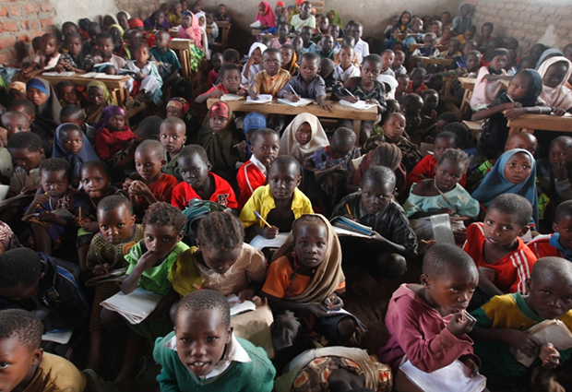
IMPACT ON TEACHERS
Harder to teach – larger classes, children with high and/or diverse needs etc
Unable to work due to crisis
Salary no longer paid
Displaced from school and home
Psychological impact
Targeted by armed groups
Recruited to armed groups
No teaching materials

Slide 7
COMMON ACTIVITIES
Temporary Classrooms or rehabilitation
Local teacher mobilisation, training and incentives
Provision of teaching and learning material
Emergency curriculum
Psychosocial Support
Community mobilisation
Activities and referrals linked to Protection, Health, WASH, Nutrition etc.

Slide 8
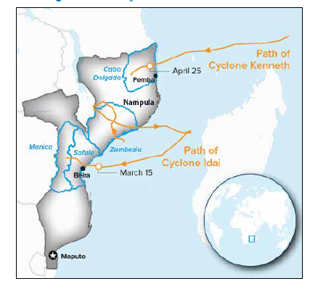
Education in Emergencies in Mozambique
The effects will continue long after life saving needs
Notes:
14-15march – idai
Cyclone Kenneth made landfall on 25 April in Cabo Delgado Province.

Slide 9
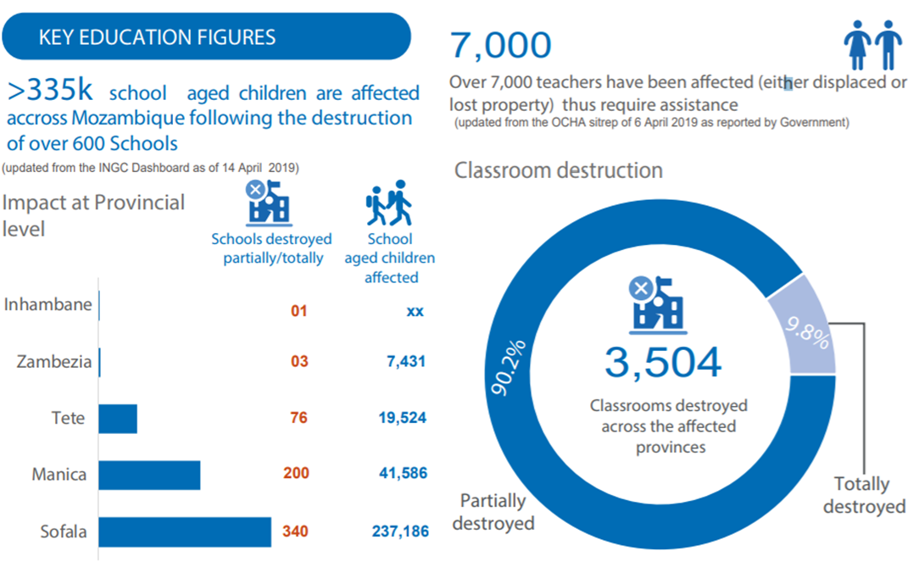
EDUCATION: Prioritised Needs

Slide 11
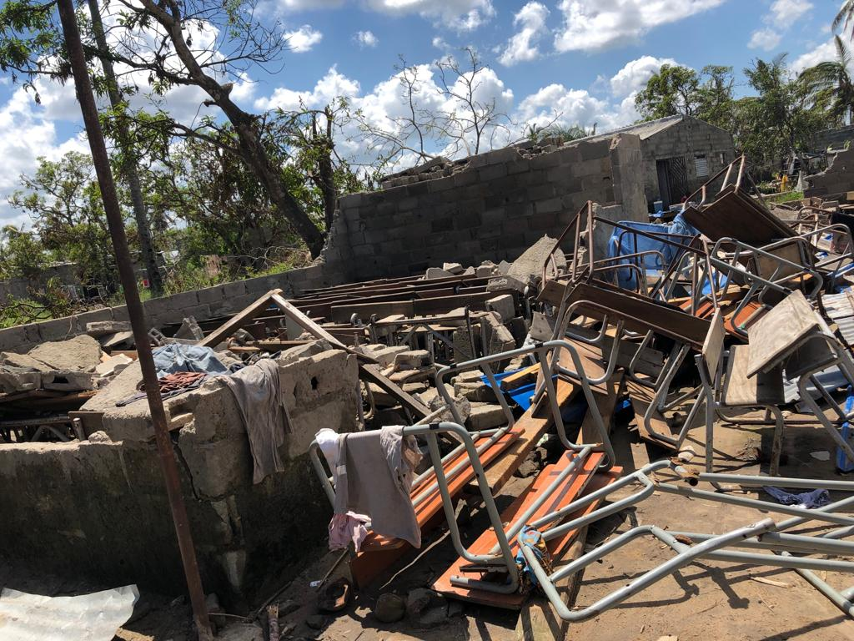

Slide 13
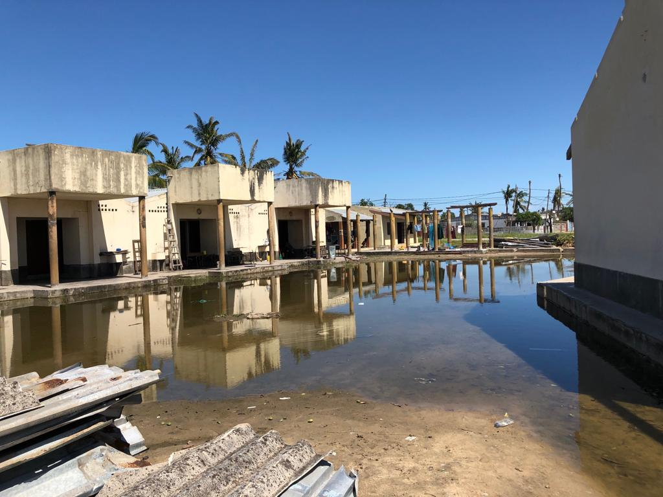

Slide 16
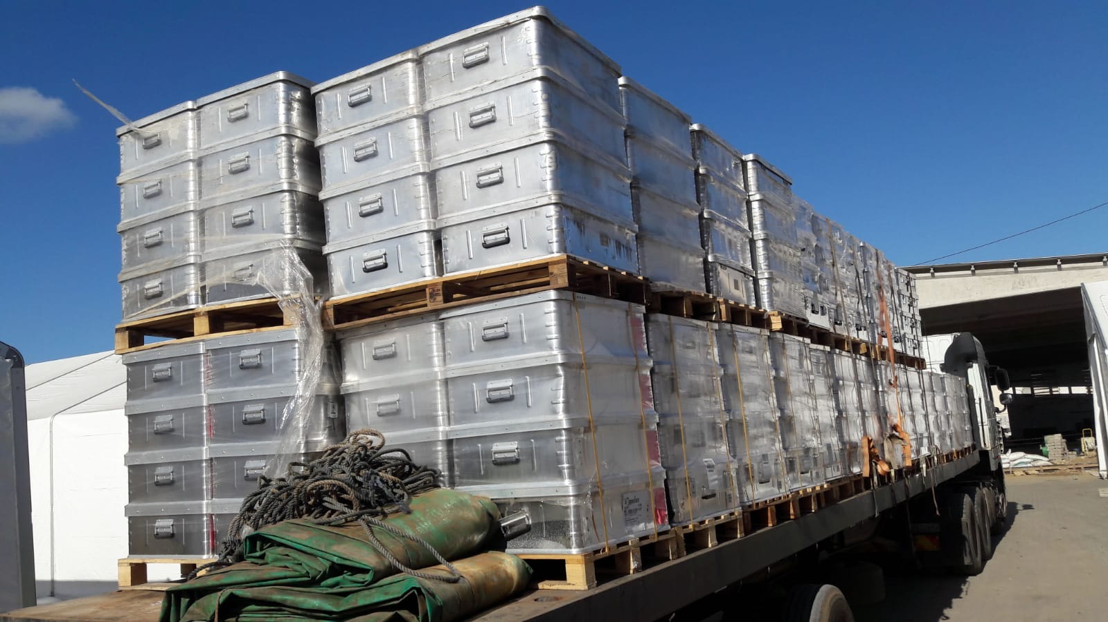

Slide 17
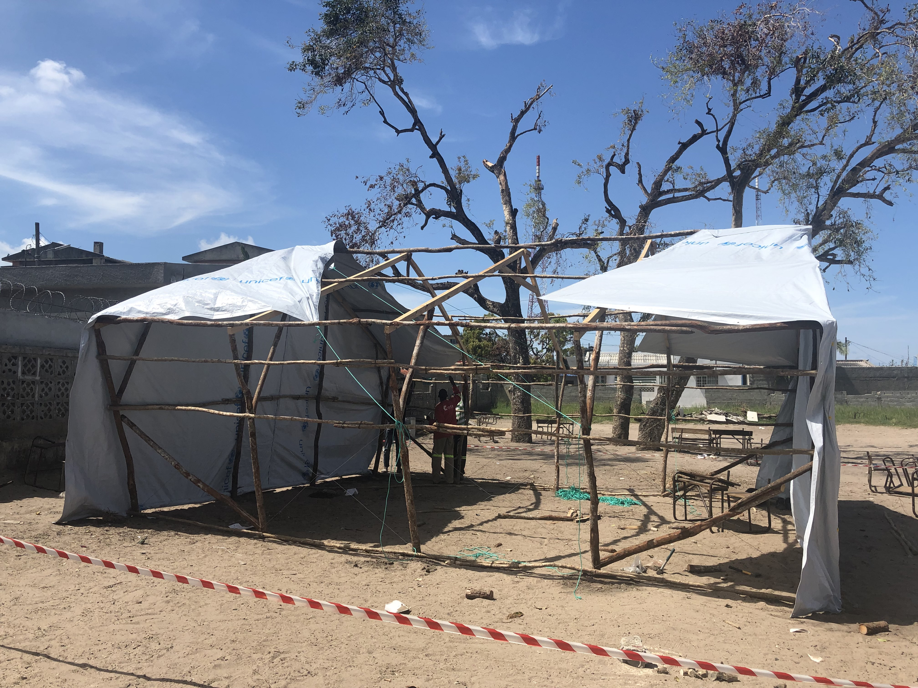

Slide 18
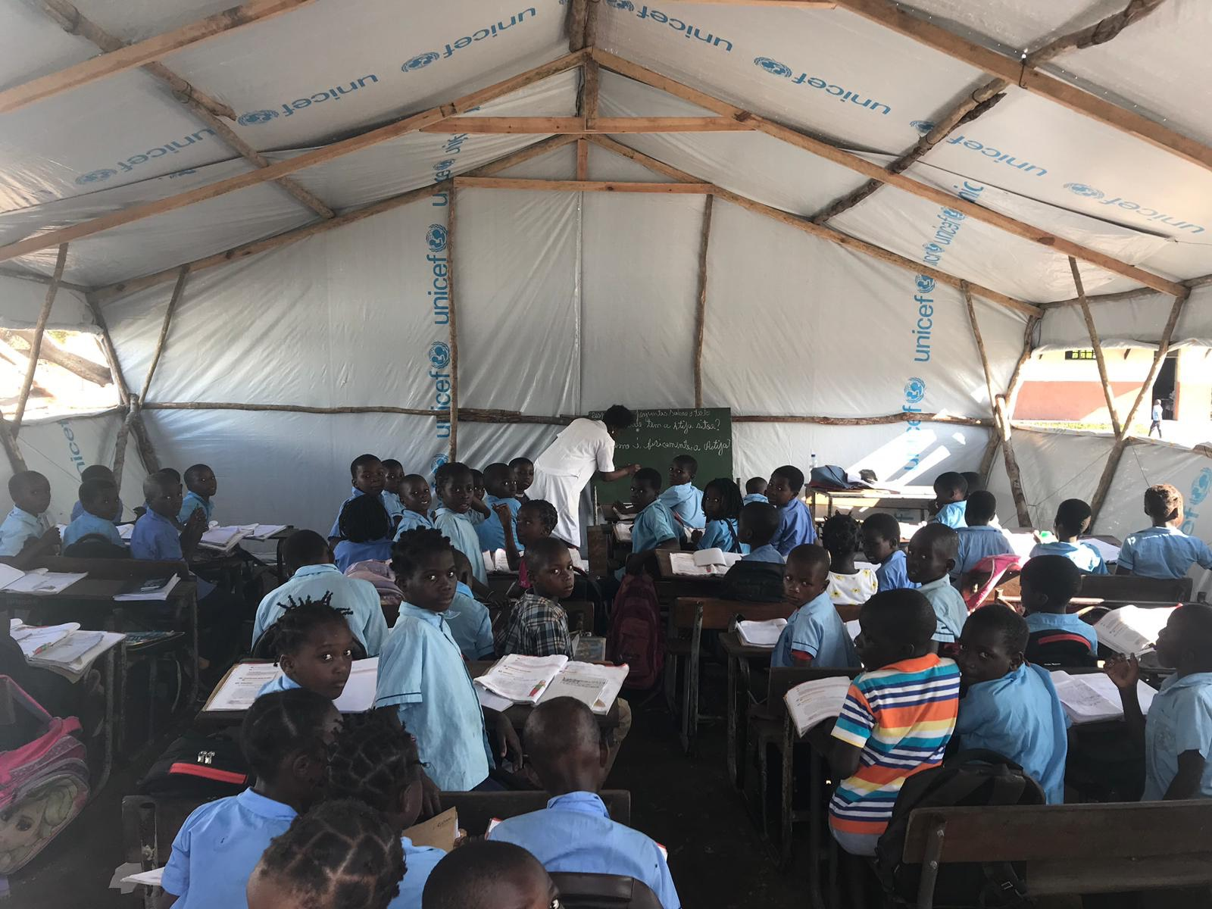

Slide 19
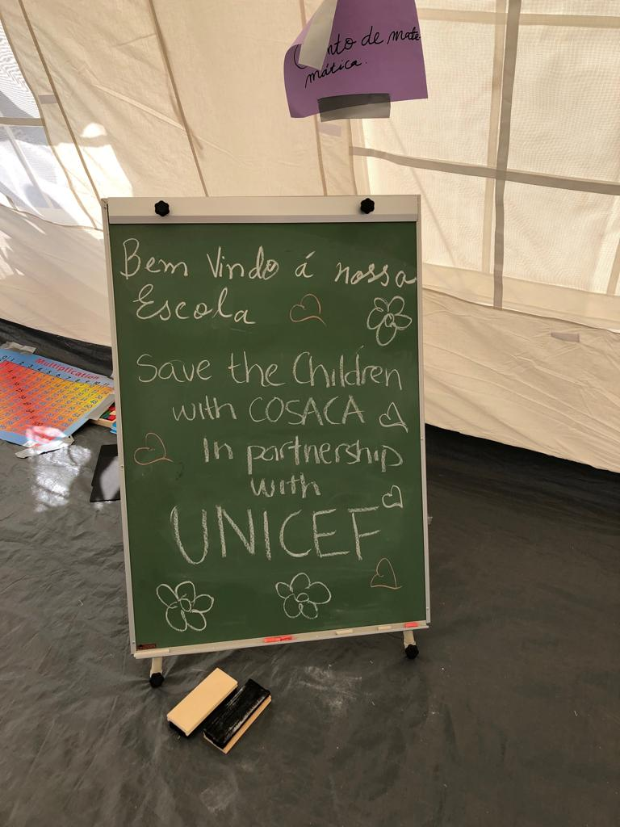

Slide 23
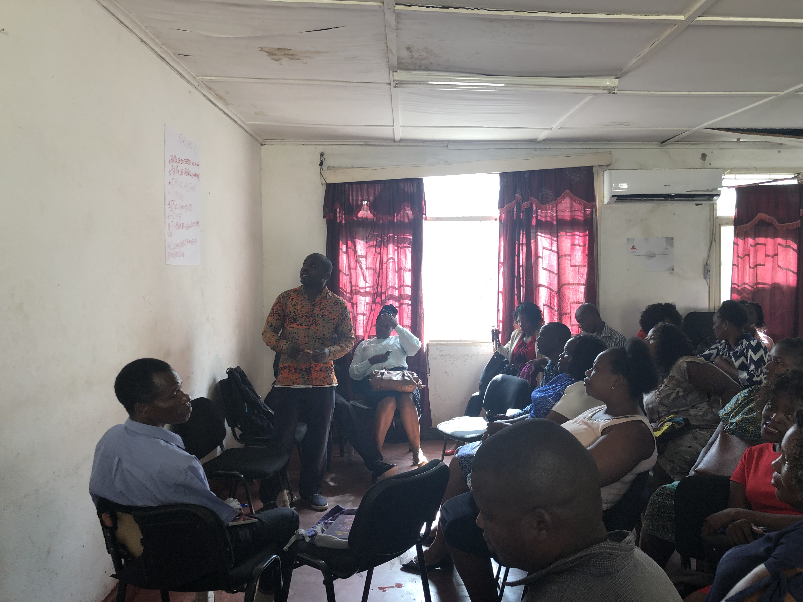

Slide 24
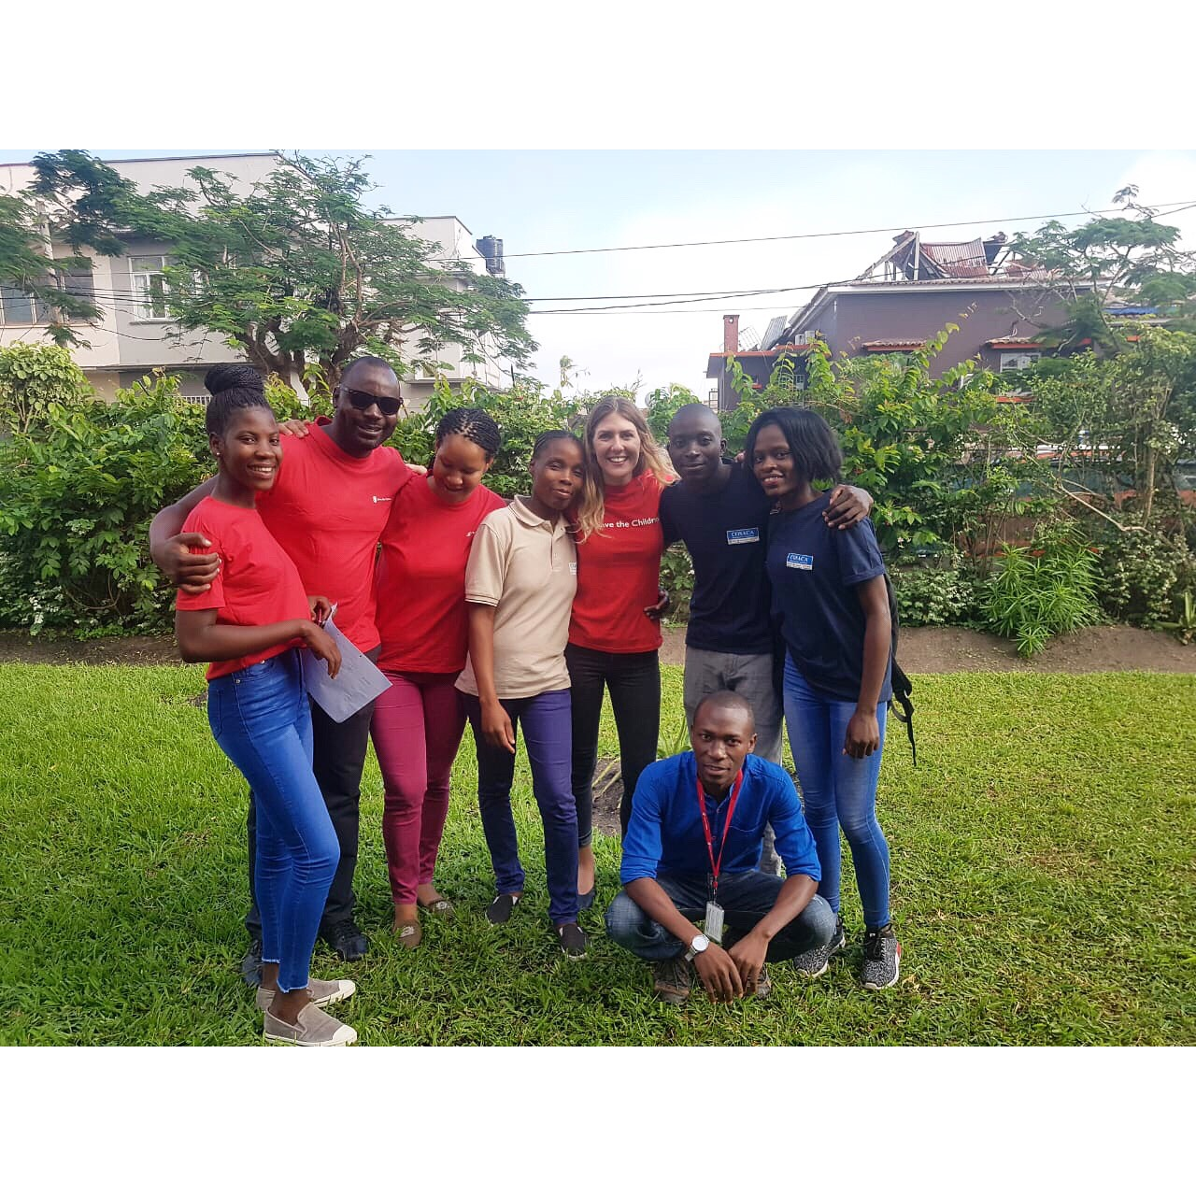

Slide 25
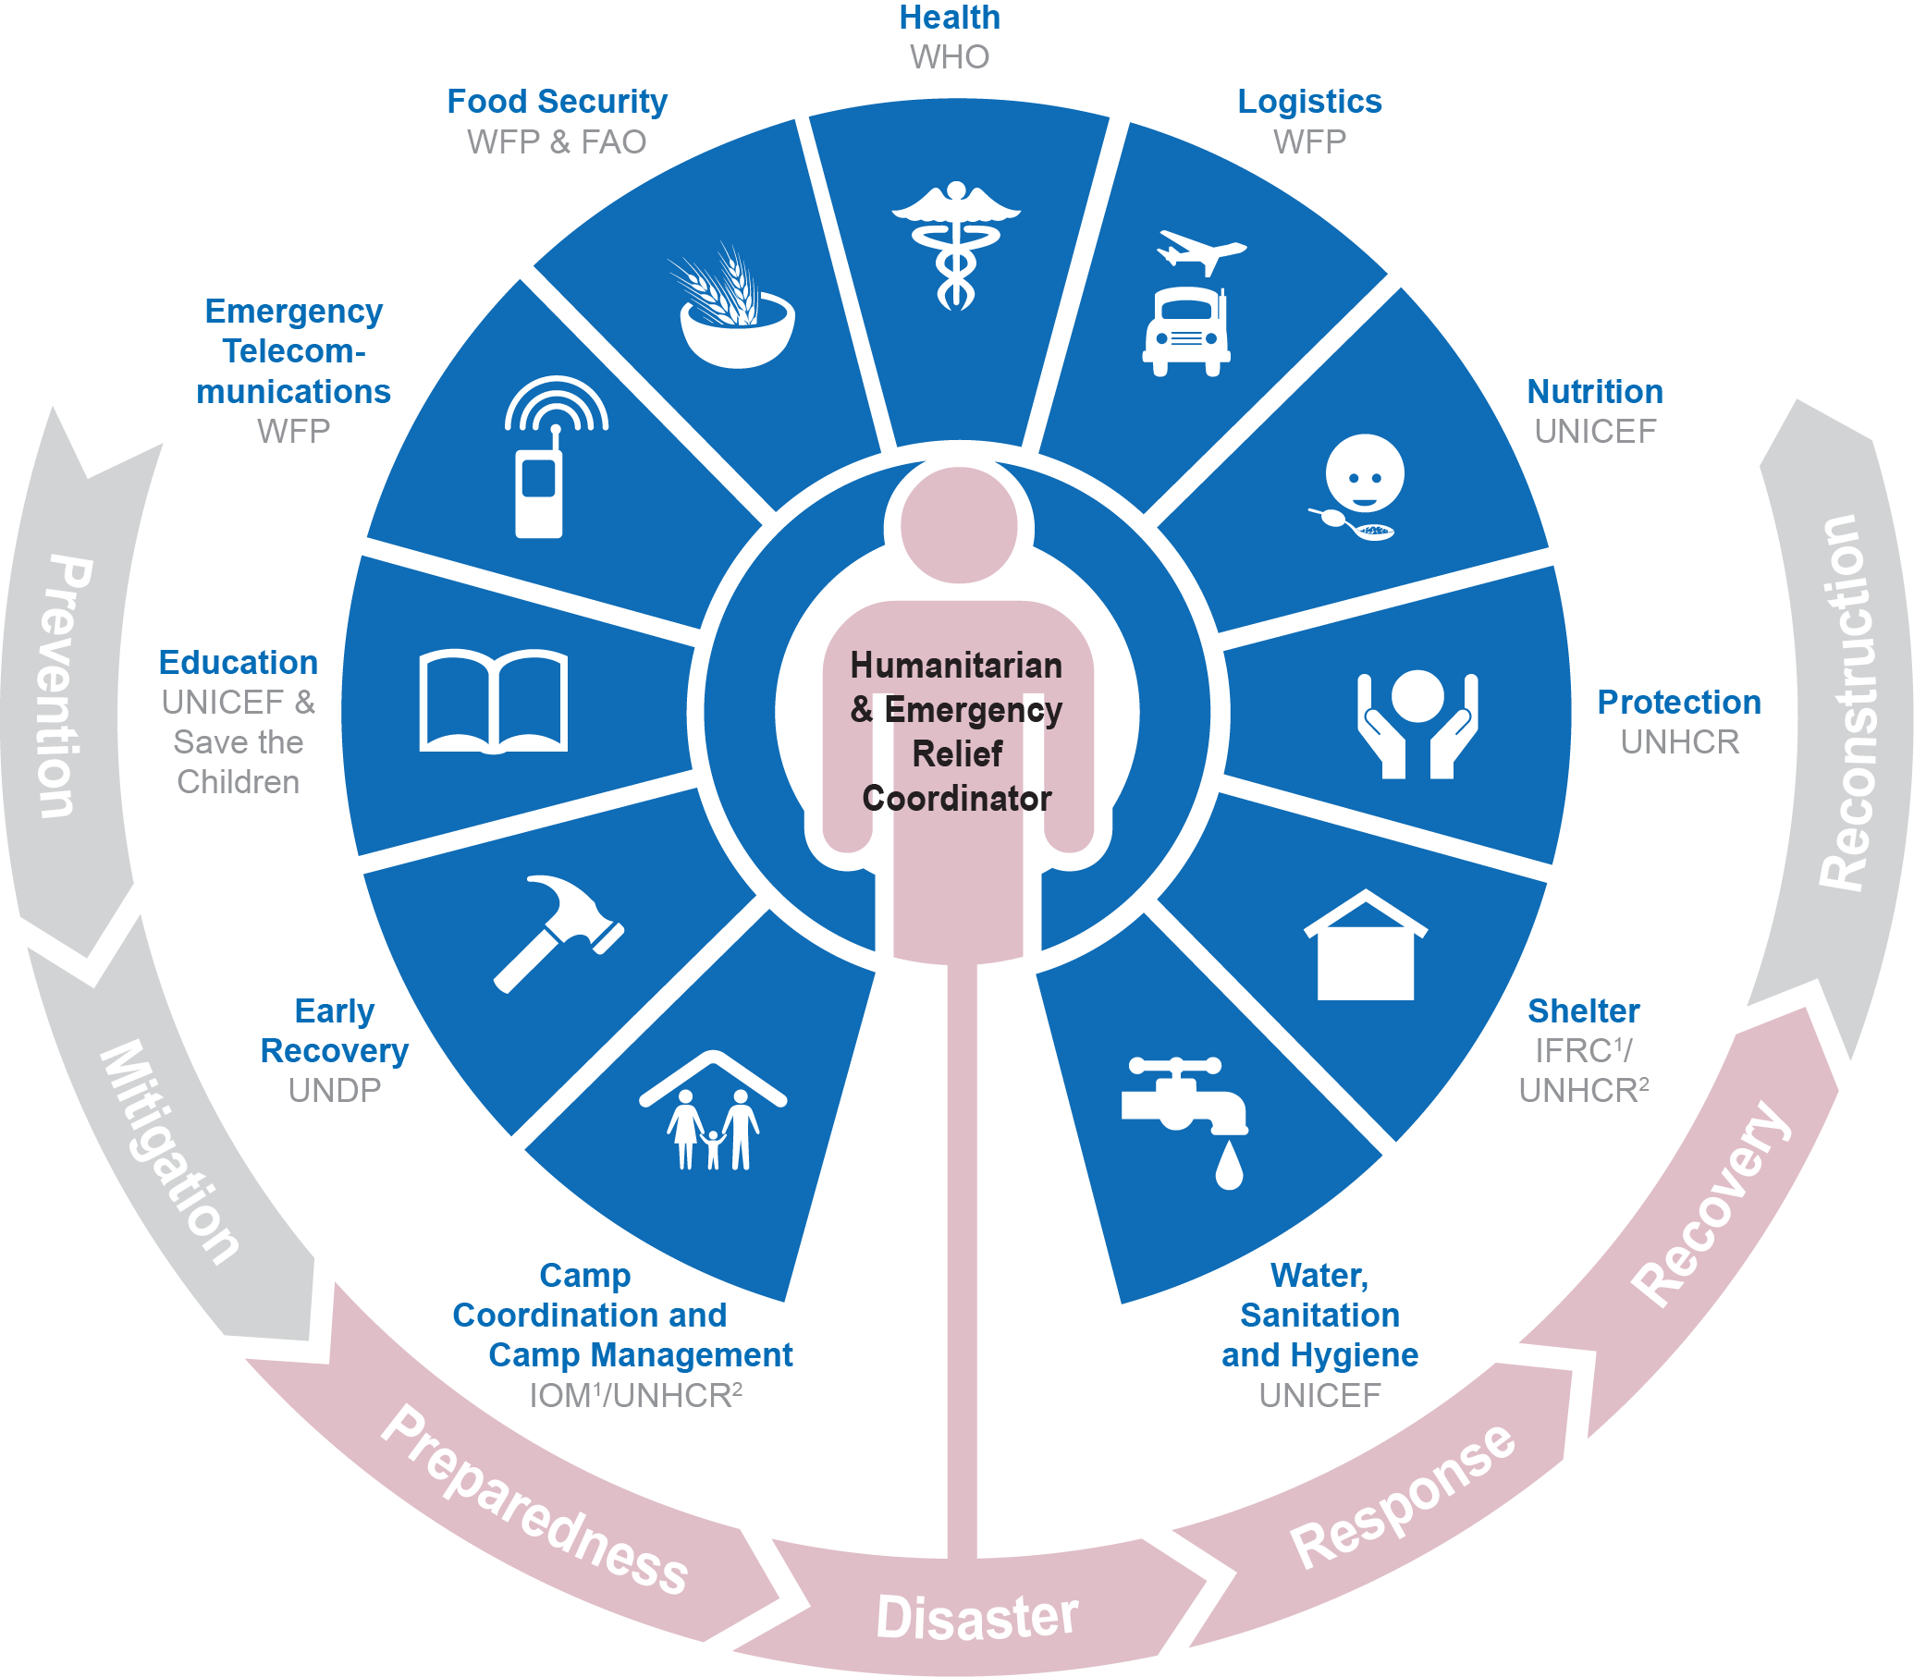
Save the Children’s position – strengthening humanitarian architecture: The Opportunity
Represent civil society
Direct access to decision making on humanitarian architecture
Be a leading agency for Education in Emergencies
Be a Voice for Children
Notes:
So now, more practically, what can this position mean for Save the Children at the global, regional and country level?
First off, as the only NGO in this cluster leadership position, it is important to use the position to represent civil society more broadly. Looking back at that table, there is no other agency in such a position
This seat also implies direct access to decision making on humanitarian architecture. Nigeria and South Sudan examples
As SC is seen as this global lead in EiE, so too can it be seen at the national level
And finally, as a child-focused agency, Save has a chance at this table to raise the voice of children at the highest levels of humanitarian decision making
As per the IASC guidance, all Clusters should be represented on the Humanitarian Country Team. As such, SC Country Director should have a seat in the HCT and should advocate with UNICEF counterpart for this seat if it is not automatically allocated on the basis of Cluster co-leadership.
Responsibility
AS CLA, it is the responsibility of SC Country Director to represent and advocate on behalf of the Education Cluster in HCT and other fora, in close collaboration with the UNICEF Representative.
Recommendation: To fully represent the Education Cluster concerns in the HCT, it is important for SC Country Director to be knowledgeable about clusters issues, as well as activities, progress, plans and issues. SC Country Director should regularly meet with the Education Cluster Coordinator and UNICEF. When speaking in the HCT, SC Country Director should make it clear when he/she is speaking on behalf of the Education Cluster, SC or the NGO community.
Opportunity
The seat in the HCT represents a great leadership opportunity:
Represent the civil society: as the only global NGO co-lead, Save the Children has the opportunity to represent and raise issues of concern for the civil society at the highest level of humanitarian architecture, both at country (HCT) but also at the global level (IASC, major events).
Influence on the decision making on the humanitarian architecture: SC is in a unique position from the outset of an emergency to advocate for the activation of Education Cluster where appropriate, and push for other important changes in the coordination of the humanitarian response.
Represent the voices of affected children at the highest level of the emergency response. This is a unique opportunity for Save the Children to raise its values (SC ambition for 2030: advocate and campaign for better practices and policies to fulfil children’s rights and to ensure that children’s voices are heard).
Be a leader for EiE:
The seat in the HCT gives SC an opportunity to ensure education is prioritized and that quality is upheld across a response. Education is often deprioritized in an emergency, when at the same time communities and children frequently list education as a top priority. The seat in the HCT gives an opportunity to ensure those voices are heard in the most critical decision making body of a humanitarian response (= accountability to affected populations).
UNICEF leads/co-leads three Clusters (education, nutrition and WASH) and two AoRs (child protection and gender-based violence). Considering this constrating, SC can take on the critical role representing education, particularly in the HCT.
SC can set the example of strong education programming by hiring strong programme managers and technical advisors who lead the development of quality programming and who are vocal leaders in the Education Cluster.

Slide 26
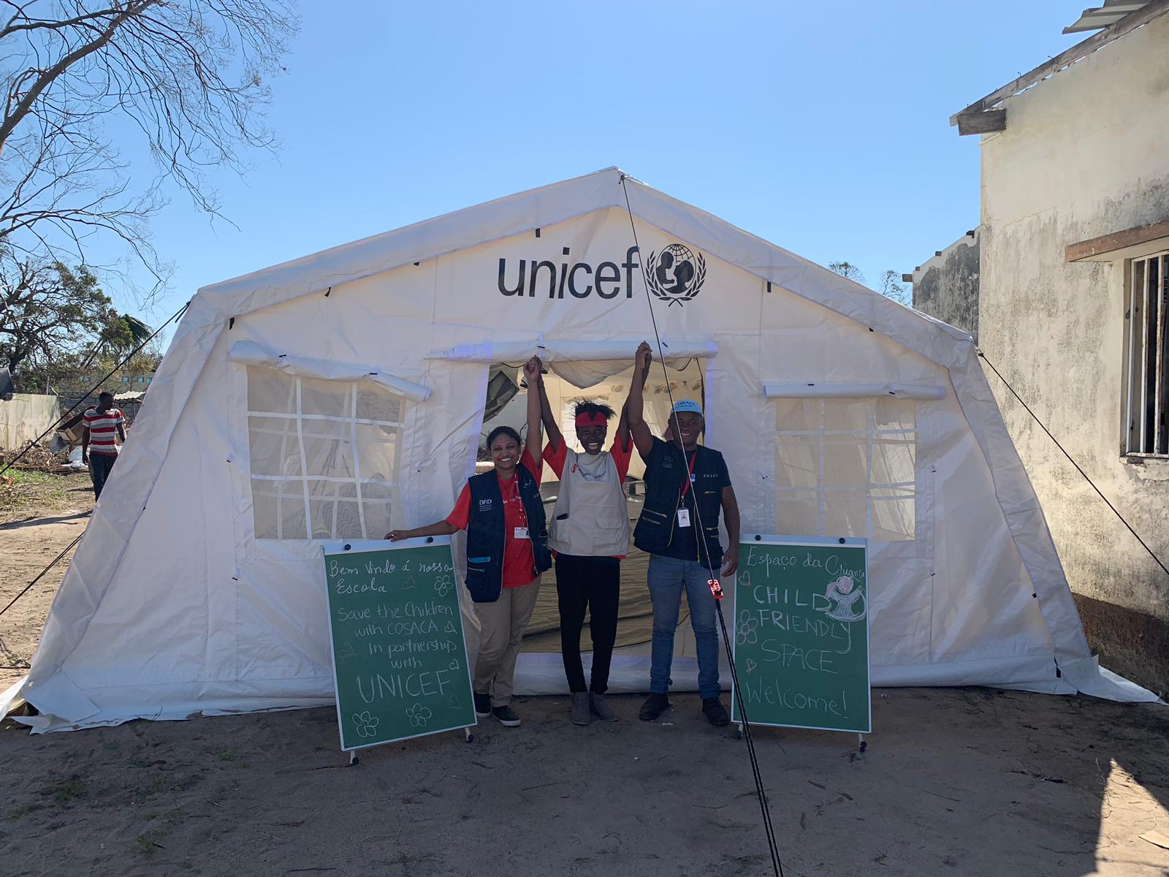

Slide 27
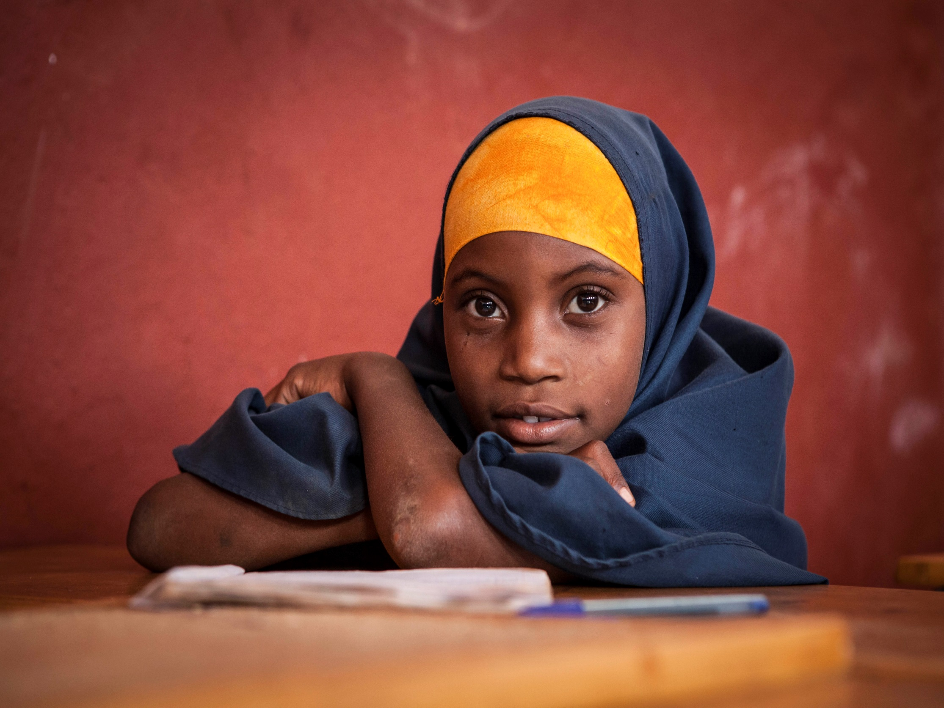
“With education I think I will have a future that won’t have to involve guns and fighting. This is my dream, that I can look into my future and see that I have options and choices. Without school you have no choices in life, you are just trying to survive.”
13-year-old, DRC
Hear it From the Children research report; Why education in emergencies is critical (2014)

