Slide 1
Impact of Rwandan Women’s Political Leadership on Democracy and Development in Rwanda Mokoro Seminar, Oxford 13 April 2016
Professor Shirley Randell AO, PhD, Hon.DLitt
Managing Director, SRIA Rwanda Ltd
Strong hearts, strong minds, strong women

Slide 2
Commonwealth Secretariat Research Study
Snapshot of the impact of women’s leadership reforms in Rwanda from 1994 – 2014, through peace and reconciliation, poverty alleviation, social and economic recovery and sustainable development, education for girls and related campaigns, legal and institutional arrangements, and compliance and sanction measures.
A taster for the full report which will be available later this year – an example of good practice and lessons learned that might be useful for other Commonwealth countries

Slide 3
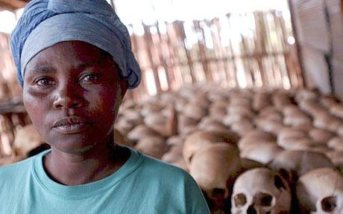
Genocide against the Tutsi - 1,000,000 cruelly slaughtered, 300,000 women raped in 100 days

Slide 4
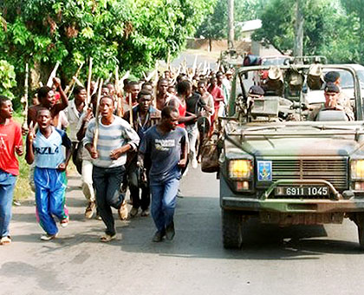

Slide 5
After Genocide
Women’s associations restarted their activities and many new groups and networks were created
Rwandan women initially made up over 70% of the population – men killed, imprisoned, fled
Ordinary women assumed leadership in the household, community and government
Women from both sides of the conflict made a remarkable contribution to reconstruction, peace and reconciliation process

Slide 6
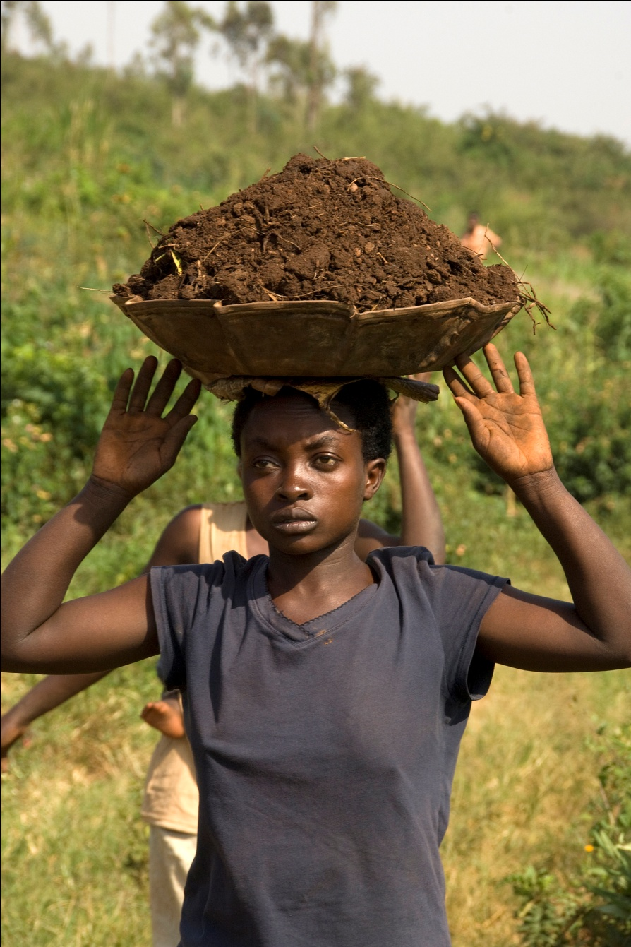
Rethinking Assumptions about Gender

Slide 7
Rwandan Patriotic Front
Incorporated women into the political and military wing from the early 1990s
Appointed women to leadership positions within the party and transitional government
Women perceived it “as an organization in which everyone found a voice and recognition”
First transitional national parliament included unprecedented number of women

Slide 8
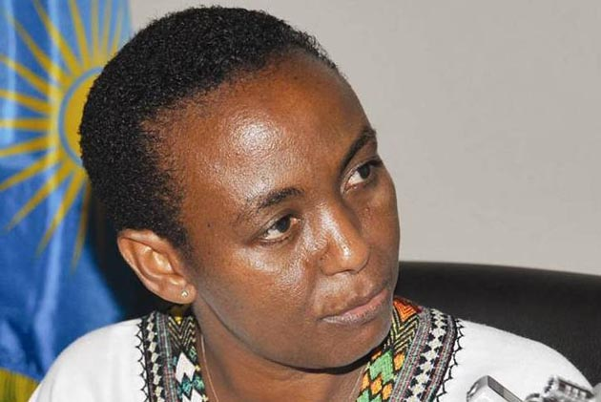
Late Hon Alyoisea Inyumba
Commissioner for the
RPF
First Minister for Gender and served again in this position
Chair Unity and Reconciliation
Commission
Senator

Slide 9
Profemmes Twese Hamwe
Grew from 13 member organisations to 35 by the end of 1996
Launched the Action for Peace Campaign in 1996 to foster dialogue
Provided training, education and mentorship opportunities for women

Slide 10
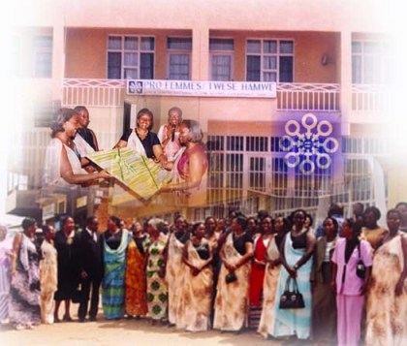

Slide 11
Rwandan Women’s Parliamentary Forum
Started in 1996
First cross-party caucus since the genocide against the Tutsi
Initial membership entirely women but now includes male associate members
Leadership has been about increasing the number of women in decision making in Rwanda – especially in politics and building capacity for inexperienced women coming into positions of leadership

Slide 12
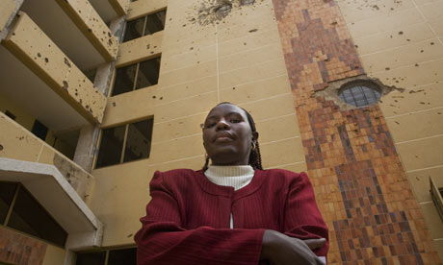
Rwandan MP Judith Kanakuze at the Parliament Building, Kigali, Rwanda

Slide 13
Reforms – 2003 Constitution
Three women on 12 person panel
Profemmes, RWPF and Ministry of Gender participated in public outreach and advocacy
New Constitution established quotas and affirmative action to increase women’s representation at all levels of decision-making

Slide 14
Constitutional Reforms
Political parties must ‘normalise’ women’s involvement in politics by internal affirmative action policies at all levels of operations
Universal suffrage
Prohibition on sex discrimination
Equal rights in marriage and divorce
Right for equal pay
Right to education

Slide 15
Women’s Strategic and Transformative Leadership Roles in Rwanda

Slide 16
Legislating Economic Security for Women
Succession Law - 1999
- equal inheritance rights to sons and daughters and protection of property rights after marriage
Land Law - 2005
- equal land rights to women and men
feed-on effects to women’s empowerment, allowing collateral for accessing credit and starting businesses

Slide 17
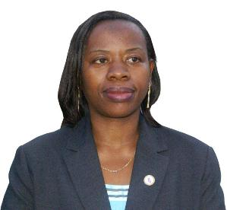
Monique
Nsanzabaganwa
Deputy Governor
Rwanda Reserve
Bank
Former Minister
Economic Affairs

Slide 18
Impact of Land Ownership
Women’s access to land tremendously contributed to their control over productive resources and access to loans at a rate of 38% in 2011.
26% of land is owned only by women
18% of land is owned only by men
54% of land is owned by both spouses
2% others

Slide 19
Impact on Agriculture
Main economic activity in country for women
Gender mainstreaming strategy with ‘smart’ programs
Connecting farmers with their neighbours
Cow-sharing schemes
Expansion of technologies linking farmers to food buyers
Localised cooperative farming programs

Slide 20
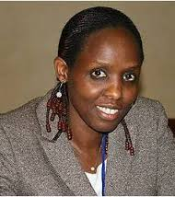
Hon Dr Agnes Kalibata
Minister for Agriculture
and Animal Resources
Chair
African Agricultural
Commission

Slide 21
Hon Gerardine Mukeshimana
Minister of Agriculture and Animal Resources

Slide 23
Husband and Wife Harvesting Yams

Slide 24
Agricultural Extension Field Staff

Slide 25
Agricultural Extension Meeting

Slide 26
Demonstration Plots

Slide 27
Impact on Poverty Reduction
Rwanda has lifted more than one million people out of extreme poverty, paying particular attention to women, who form the majority of the poor
Extreme poverty 36% in 2005 to 24% in 2010
Percentage of poor women-headed households
- 66.3% in 2001 to 47% in 2010/11
Poverty alleviation progress among all households
- 56.9% in 2005 to 44.9% in 2010

Slide 29
Social and Economic Recovery and Sustainable Development

Slide 32
Women’s Leadership in Social and Economic Recovery
Gender-sensitive budgets in all agencies – how they will benefit women and children
Women’s cooperatives – Gahaya Links employs over 5000 women in over 40 cooperatives and has annual revenues of over 500 million RWF
“People never used to think that women were able business women or able business managers…we have proved that women can be, and perhaps and can even do better in business than men”

Slide 33
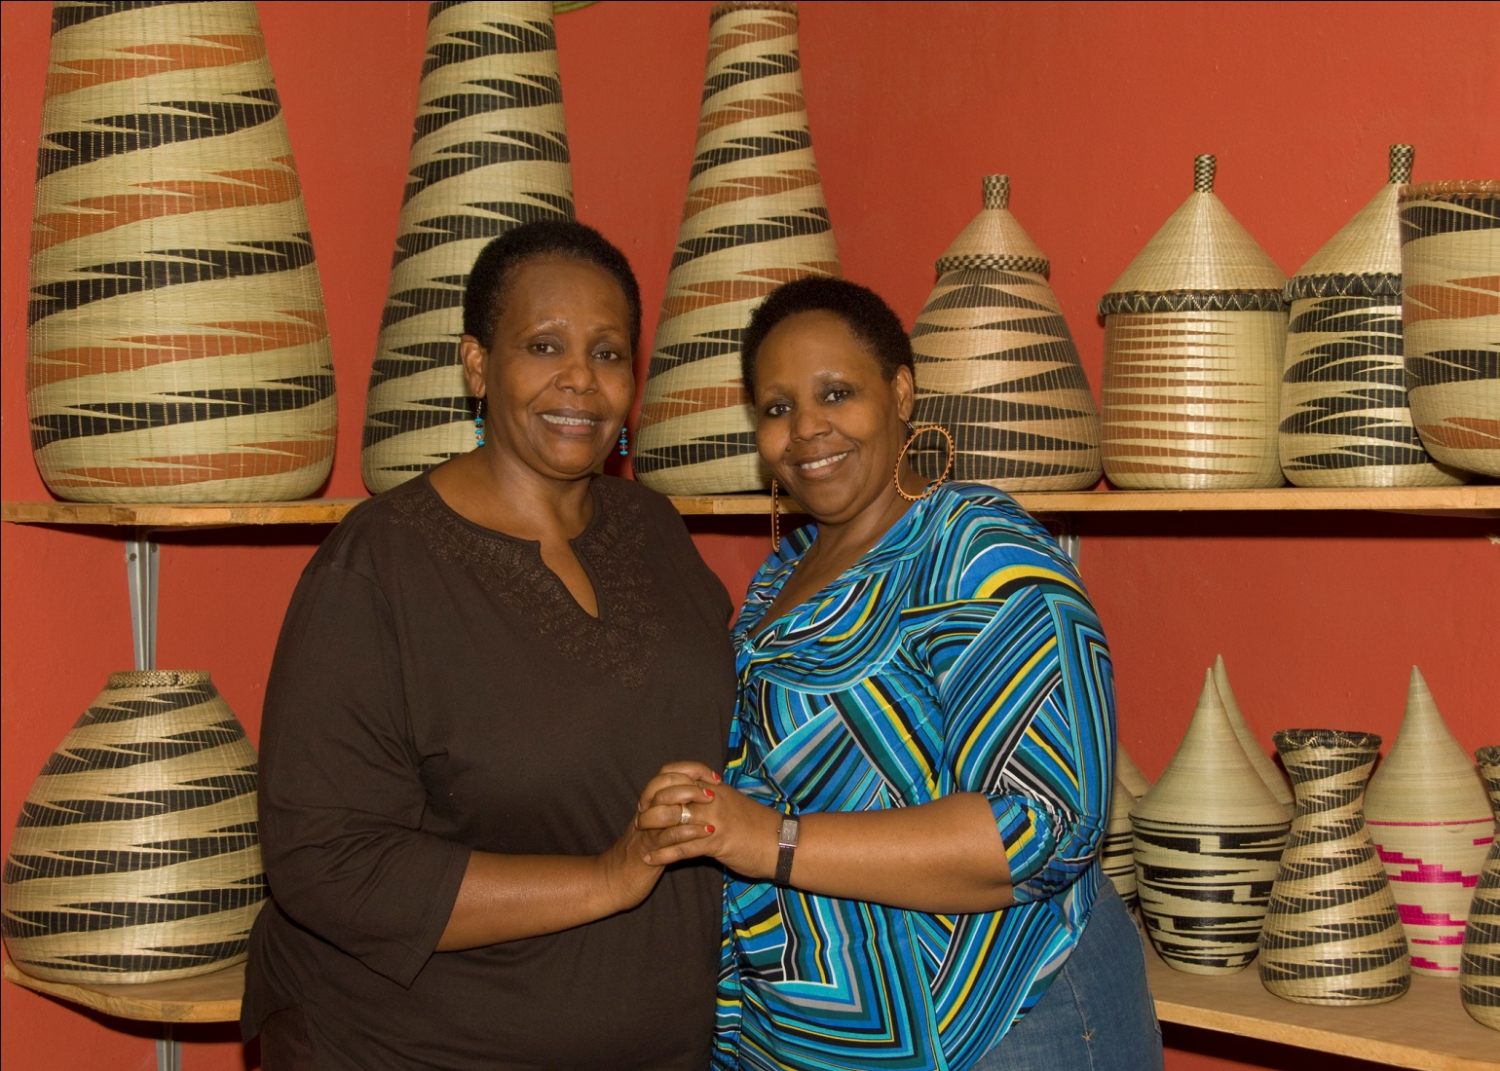
Women’s Cooperatives

Slide 34
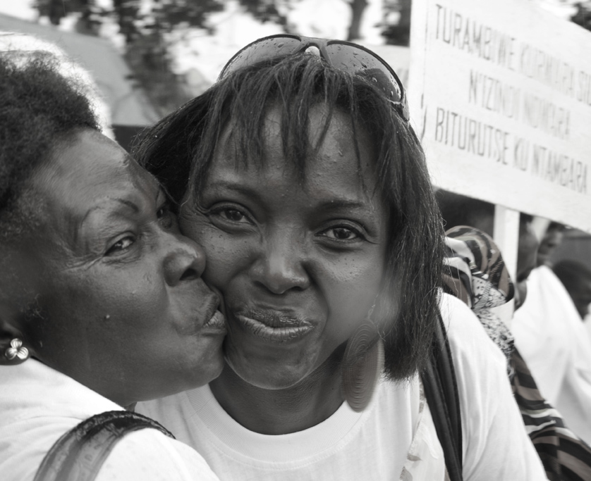
Connections for Equity between Survivors and Perpetrators

Slide 35
Impact on Education
Rwanda has surpassed the MDGs target of cutting the illiteracy rate by half by 2015
Rwanda is in top three countries globally to achieve universal primary education goals.
Policies on Early Childhood Education and Technical and Vocational Education and Training
First Lady’s Imbuto Foundation rewards high achieving girls and encourages them to go on to science studies

Slide 36
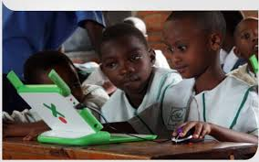
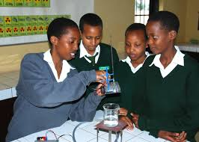

Slide 37
Leadership developed by Participation in Academic Institutions
Both within Rwanda and overseas
Rwanda Association of University Women
Centre for Gender, Culture and Development
Changes have come about by increasing the number of educated women in decision making in Rwanda
Creating opportunities for women and girls through education and mentorship

Slide 38
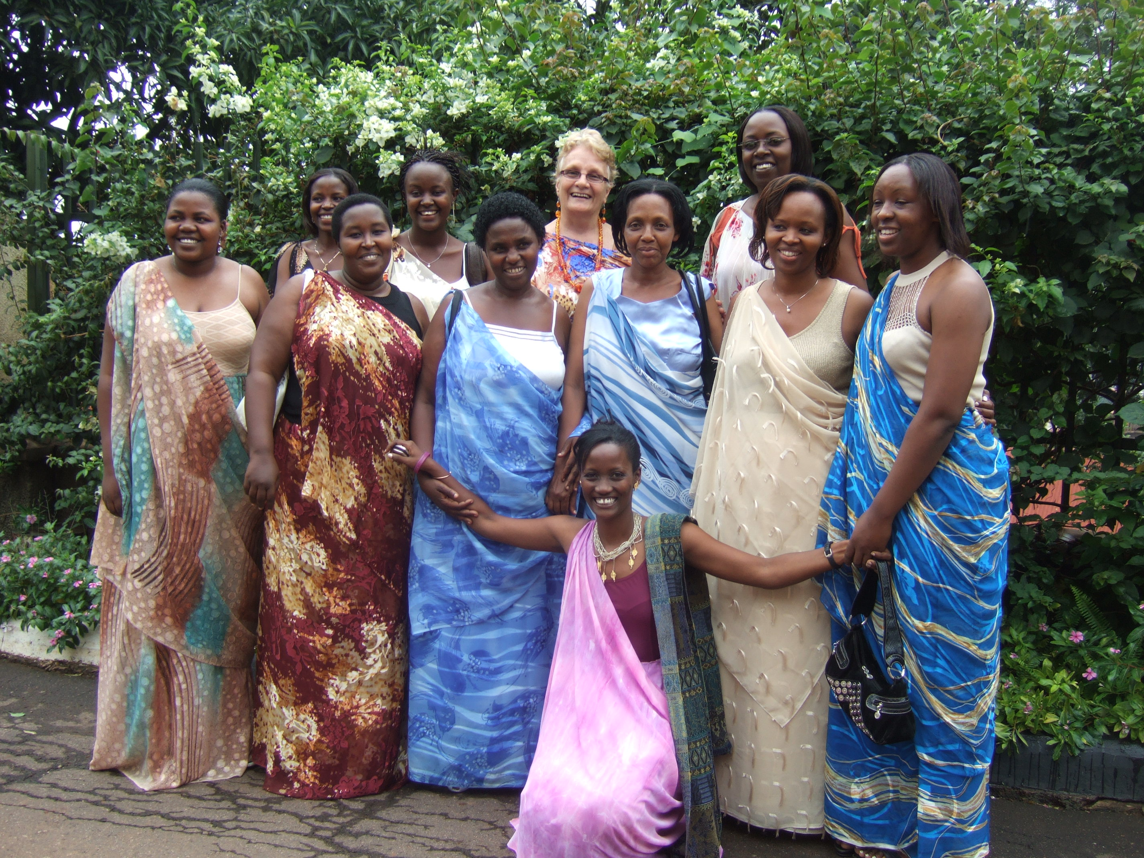
Members of the Rwanda Association of University Women

Slide 39
Breaking the Silence on Menstruation

Slide 40
Colloquium on Women in Leadership in Higher Education

Slide 41
Centre for Gender, Culture and Development

Slide 42
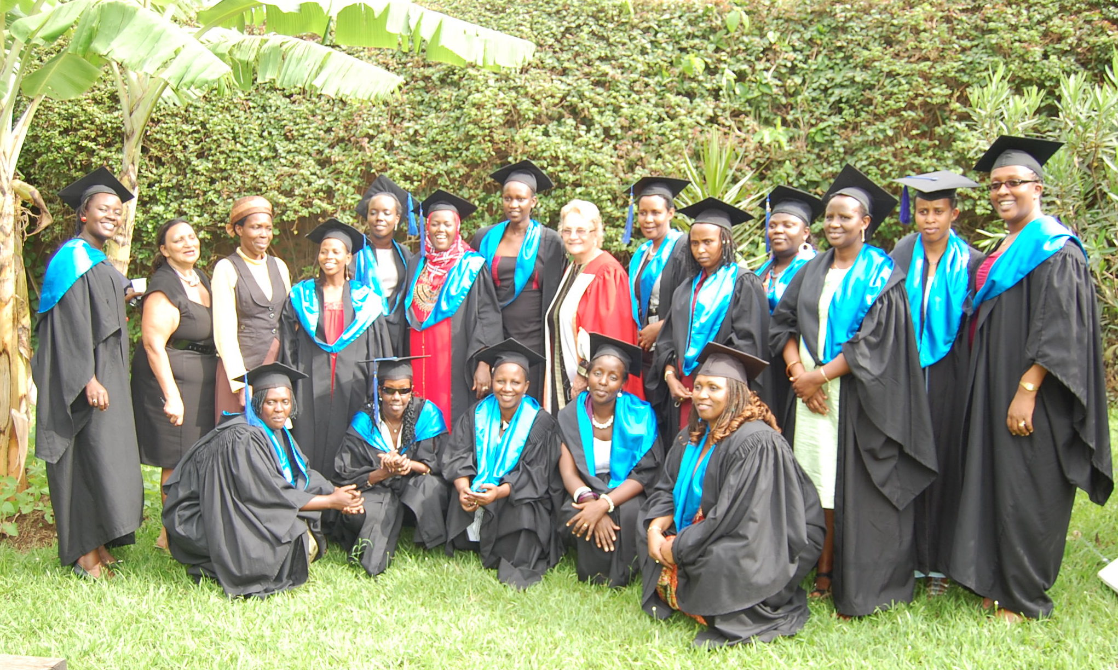
Master of Gender and Development
2011/12 Graduates

Slide 43
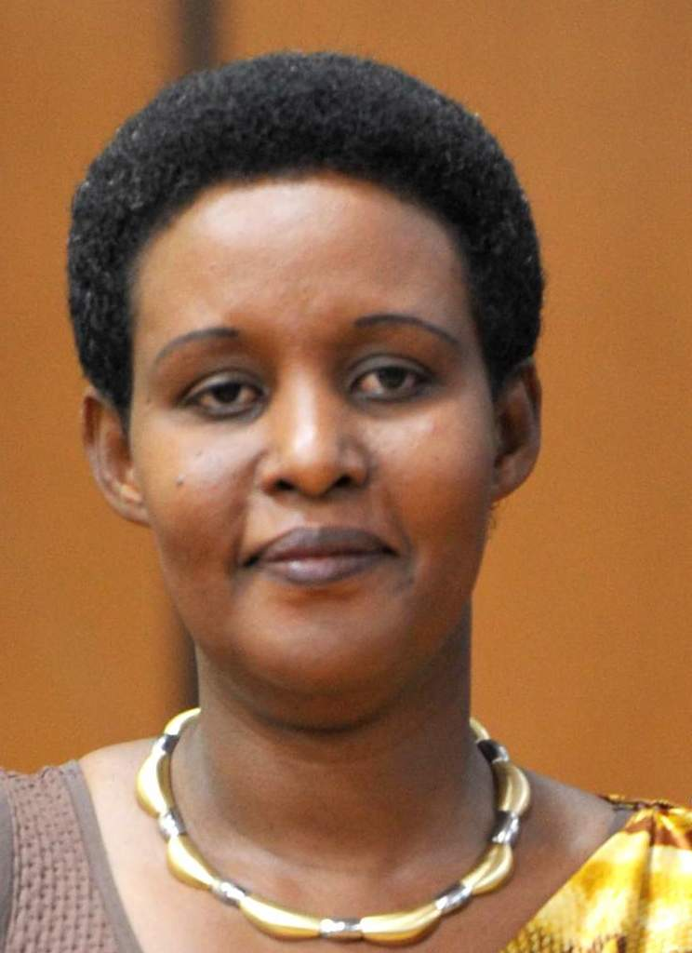
Hon Oda Gasinzigwa MGD
President National Council of Women
First Chief Gender Monitor
Gender Monitoring Office
Minister for Gender and Family Promotion

Slide 44
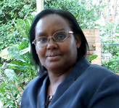
Angelina Muganza MGD
Executive Secretary
Public Service Commission
formerly
Second Minister for
Gender and Family
Promotion 1997-
Minister for Labour
2006-2011

Slide 45
Impact on Health
Rwanda is the first low-income country in the world to provide free universal access for the HPV vaccine for adolescent girls
The country is on track for meeting the MDG 4 target. The proportion of children receiving all basic vaccinations by 1 year of age has reached 90.0%
The increased use of modern innovative mobile technologies, including rapid SMS for emergency labour and tracking the Maternal and Child health continuum of care have resulted in considerable decrease of maternal and infant mortality rates.

Slide 46
Impact on Health
Unprecedented reduction in fertility rates between 2005 and 2010
- 6.1 children per woman in 2005, 4.1 in 2010
Infant mortality rates
- 8.6 deaths per 1000 live births in 50 in 2010
Maternal mortality rates
-1070 deaths per 100,000 in 2005, 476 in 2010
98.3% of adolescent girls know at least one method of contraception

Slide 47
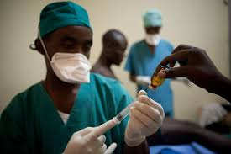
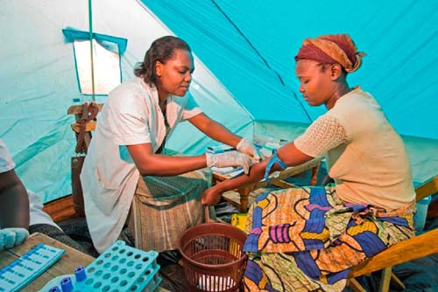

Slide 48
Women and Political Participation
Women’s political leadership begins in women’s group at cell level through sector, district, province to nation
Rwandan Women’s Parliamentary Forum
Unity Club
Take action to ensure that new members are mentored and capacity is built
Women in parliament influence not only the political agenda, but also the way women and men are perceived in society

Slide 49
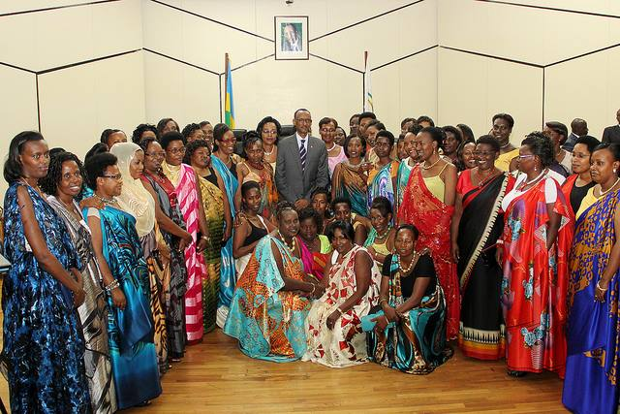
Rwandan Women Parliamentarians, 2013 Election

Slide 50
Hon J. Kasengwa, MP Rwanda, Vice President, Pan-African Parliament
It is true that gender equality in political participation goes beyond just numbers, but numbers must be there in the first place, then these numbers must be modeled into effective, able resources to be used to secure gender equality in political participation, including influencing and shaping political will of all the stakeholders, to gender equality.

Slide 51
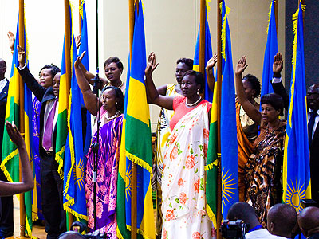

Slide 52
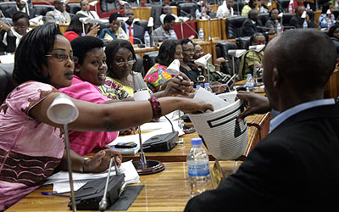

Slide 53
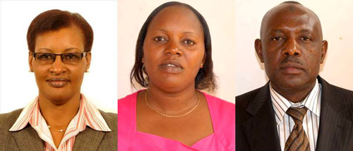
Donatille Mukabalisa, Speaker; Jeanne d’Arc Uwimanimpaye, deputy speaker in charge of legal affairs and control of government activities; Abbas Mukama, deputy speaker in charge of finance and administration

Slide 54
Hon Louise Mushikiwabo
Minister for Foreign Affairs
and Trade
President Security Council

Slide 55
Women in Decision-Making Bodies
64% of Deputies are women – Rwanda is the only country in the world where women are a majority of Parliament
37% of Senators
40% of Ministers
40% of Judges in the Supreme Court
40% of Provincial Governors
38% of District Councillors

Slide 56
Institutional Mechanisms for the Advancement of Women
Ministry of Gender and Family Promotion – coordinates and advocates for the formulation of gender equality laws, policies and programs
National Women’s Council – organises, mobilises and advocates for women’s participation in national development
Gender Monitoring Office – monitors the respect of gender equality, GBV prevention and response and promotes gender accountability
Rwanda Women’s Parliamentary Forum (FFRP) – oversees and advocates for the enactment of gender-sensitive laws

Slide 57
Impact on Anti-Corruption
Anti-corruption entrenched in society like gender
In 2014 Rwanda least corrupt country in the East African Region
Fourth least corrupt country in Africa
Among the top 50 best performing countries of 177 surveyed globally by Transparency Int.
Women hold significant roles- Chief Justice, Ombudsman, Gacaca courts, Judiciary, Supreme and Commercial Courts

Slide 58
Political participation through Women’s Networks
- National Council of Women
- National Rural Women’s Network
- Profemmes Twese Hamwe
- Women’s Chamber of Commerce
- YW for Impact
Change has come about by increasing the number of women in decision making and the economy in Rwanda
Involving women’s grassroots movements in all gender initiatives

Slide 59
National Council of Women

Slide 60
National Council of Women

Slide 61
Rwanda Rural Women’s Network

Slide 62
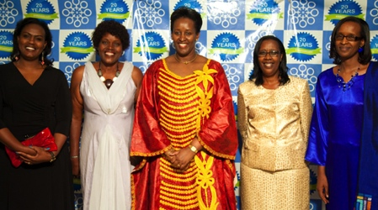
Profemmes Twese Hamwe Executive with First Lady,
20th Anniversary

Slide 63
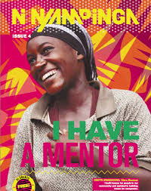
GirlHub
Rwanda

Slide 64
Women’s Chamber of Commerce
Empowering women can fundamentally transform post-conflict economies and fight the cycle of poverty.

Slide 65
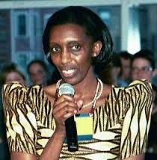
Lieutenant Colonel
Rose Kabuye
Protocol Officer for
the President
Business woman

Slide 66
International and Regional Peace and Development
Rwandan women have not only contributed to conflict mediation at home but have exported peace to other parts of the world.
From 2005 to May 2014, up to 446 women police officers have served in UN and AU peacekeeping missions. Including Sudan (Darfur, Khartoum), South Sudan, Haiti, Ivory Cost and Liberia, Mali and Central African Republic.
The National Action Plan for the Implementation of UNSCR 1325 (2009-2012) was adopted and sought to reinforce the capacity of women in peace and security processes.

Slide 67
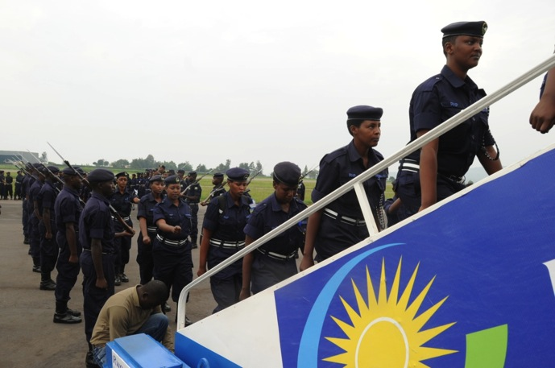
RNP Gender Promotion
Training of Rwanda National Police in SGBV
Awareness raising of SGBV crimes
123 female RNP officers in four countries (Sudan, Haiti, Chad, Liberia, Sierra Leone)

Slide 68
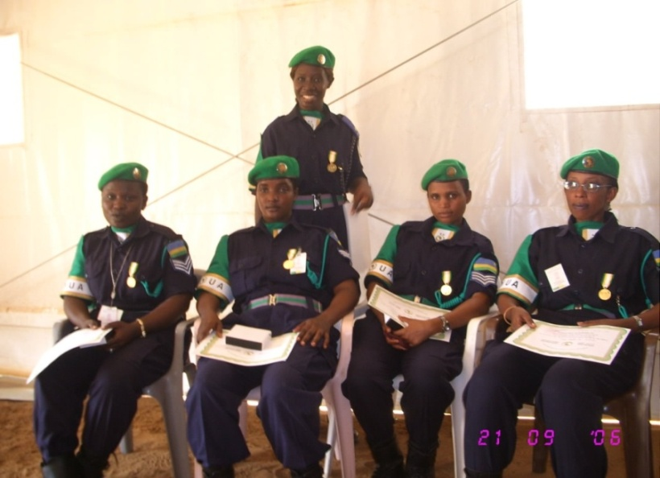
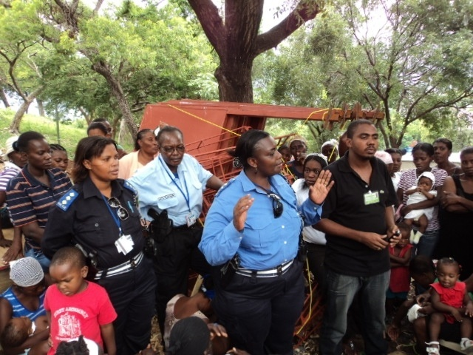
RNP Women’s Integration in Peace Support Operations
Rwandan women police in Darfur to assist women and children to access justice
Women participate in UN Missions and share experience in handling GBV
2005 Rwanda Police sent its first contingent to Darfur’s AU-AMIS
Mobile Gender Unit in IDP camp in Port au Prince, Haiti.

Slide 69
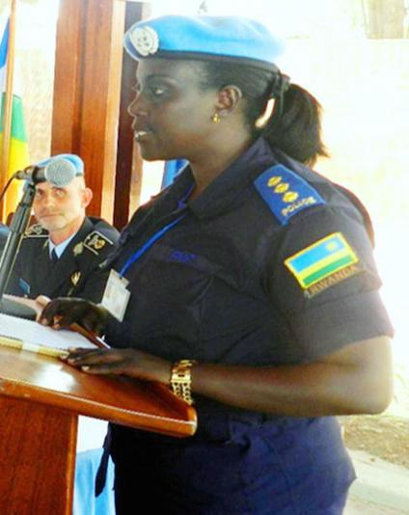
In October 2014 a Rwandan national police officer Chief Inspector of Police, Antoinette Umuraza, was appointed chairperson of the United Nations Police Women Network under the UN Multidimensional Integrated Stabilisation Mission in the Central African Republic (CAR).

Slide 70
Legislating an End to Gender-based Violence in Rwanda
2004 study estimated that one out of every two women experienced domestic violence
Between 2002-2004, 6,440 GBV crimes reported to the National Police; 75-80 percent of victims were under the age of 18

Slide 71
RWPF - Mobilizing for a new law
Draft legislation used intentionally inclusive language emphasizing importance of men as sons, fathers and husbands
Male parliamentarians participated in public outreach and consultations
Men held meetings with local male leaders about GBV
Bill co-sponsored by four men and four women

Slide 72
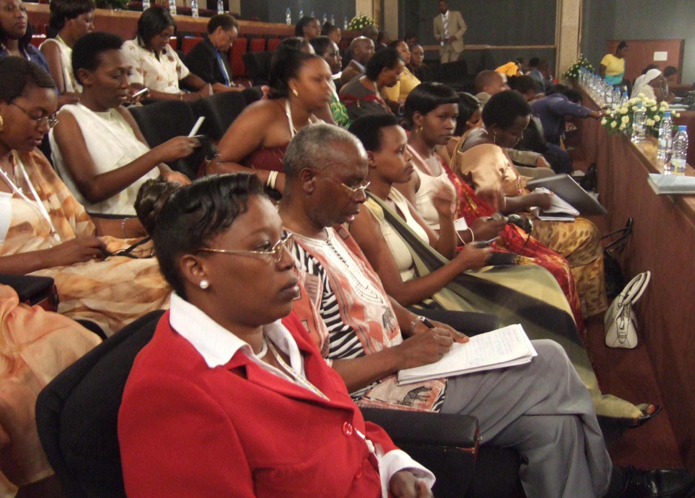
Support from the gallery

Slide 73
Criminalizing GBV
Law on Prevention and Punishment of Gender-Based Violence passed in 2008
Describes GBV as ‘various sexual, psychological, bodily and economic crimes committed on the basis of sex’
Rape, infant assault and sexual harassment between married couples are included in the law

Slide 74
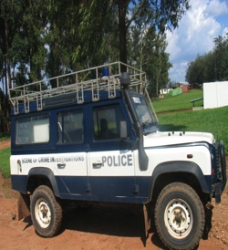
Best Practices in Prevention and Response to GBV-Police Gender Desks-2012
Rapid field response
Free telephone hotline 3512
Investigation
Counseling
Community mobilization
Networking with partners
Training officers on GBV

Slide 75
GBV response mainstreamed
Gender desks – police and military
Training – law enforcement
Communication and awareness-raising
Community-based approaches
Multi-sectoral approach
One-stop centres

Slide 76
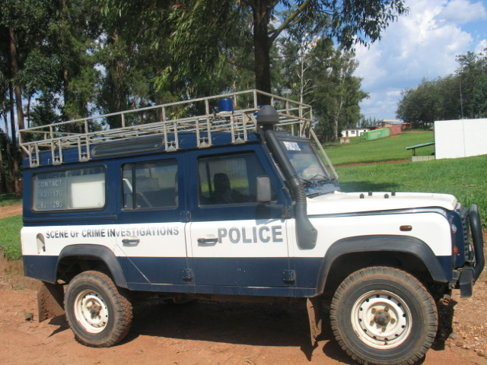
Best Practices in Prevention and Response to GBV
Rapid field response
Free telephone hotline 3512
Investigation
Counseling
Community mobilization
Networking with partners
Training officers on GBV

Slide 77
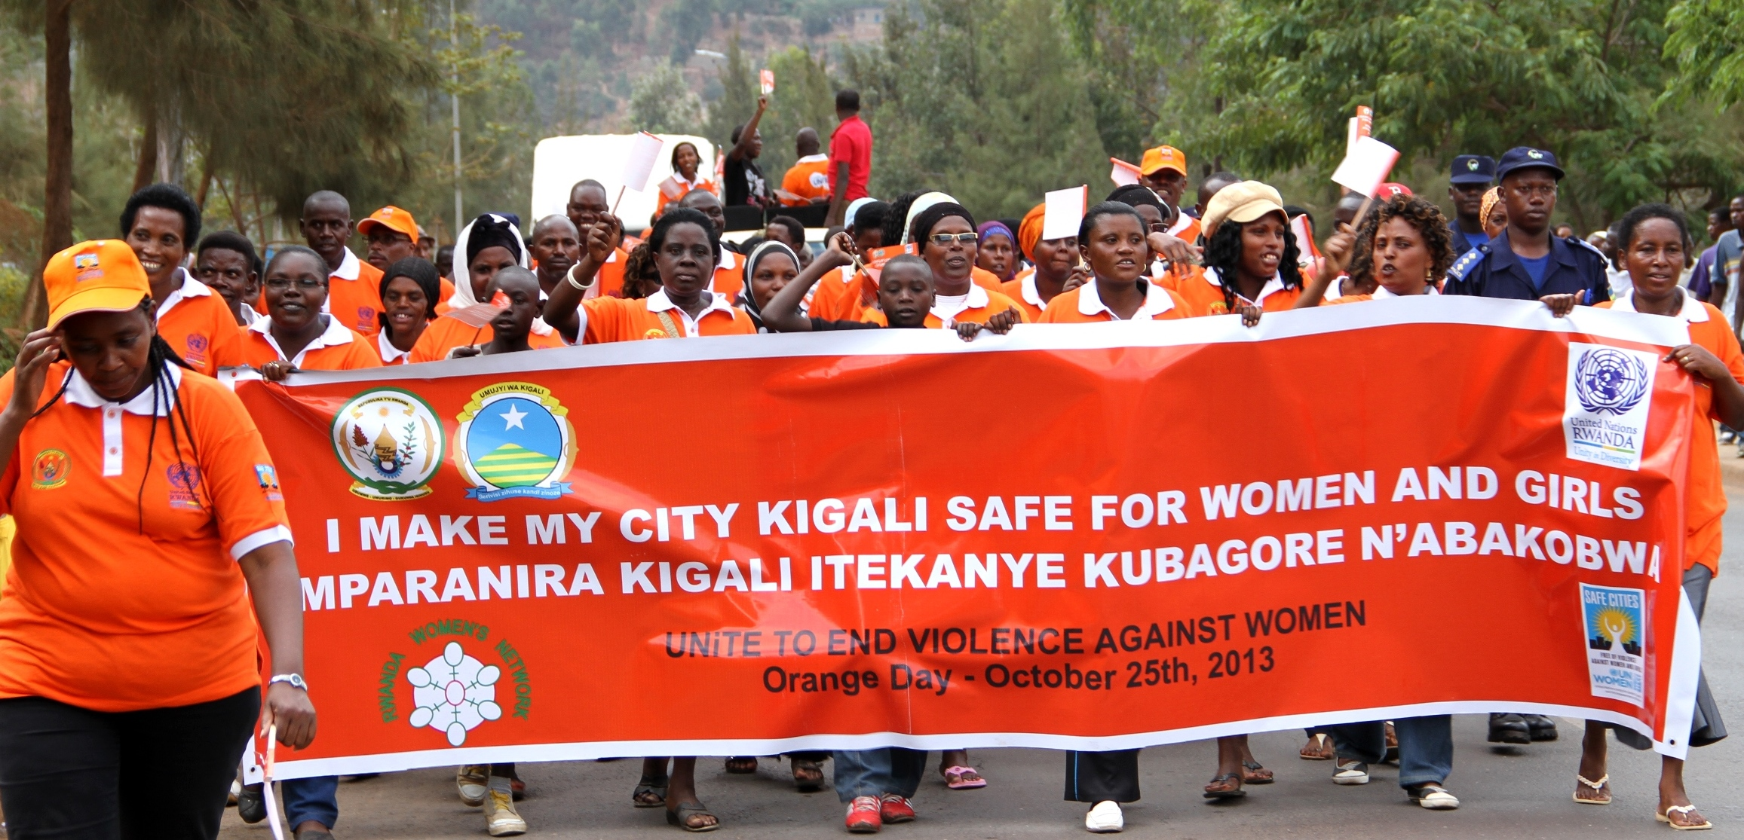
Rwanda Men’s Resources Centre

Slide 78
March for Women for IWD

Slide 79
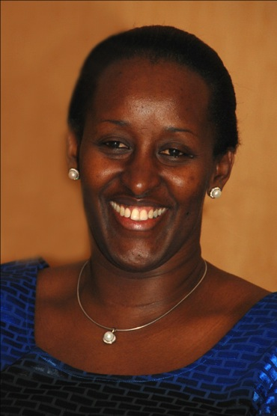
Important Contribution of First Lady of Rwanda
Imbutu Foundation
Scholarships for orphans
Prizes for the
best girl students
at every level

Slide 80
First Lady HE Jeanette Kagame
Men and women together in Rwanda have developed the right collective mindset towards post-conflict transformation

Slide 81
Men and Women in Partnership

Slide 82
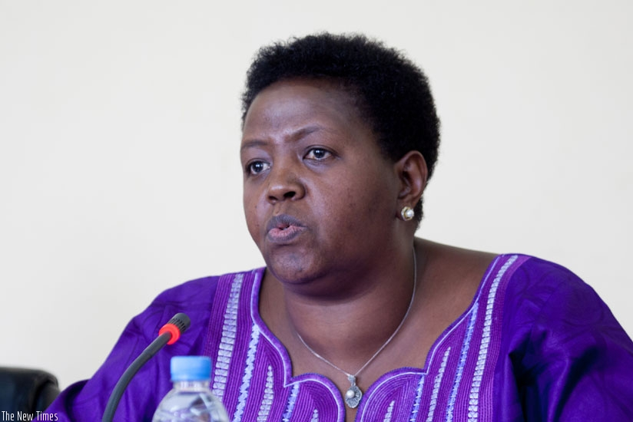
Hon Fatuma
Ndangiza,
Deputy Chief
Executive
Rwanda Governance
Board

Slide 83
Inclusive Governance
Inclusive governance in which no one is left out through power sharing is the core for sustainable democracy and governance and that is what states should strive for in the Great Lakes Region

Slide 84
H.E President Paul Kagame, speaking at the Fifth Tokyo International Conference for African Development, June 2013
It is now possible to foresee a time soon when women in top leadership positions will no longer be an exception but rather one where women’s ability to lead will be so usual that no one will remark about it. Ultimately, the most effective and long-lasting guarantee to women’s equality and increased participation in economic activity is education – to acquire knowledge and skills.

Slide 85
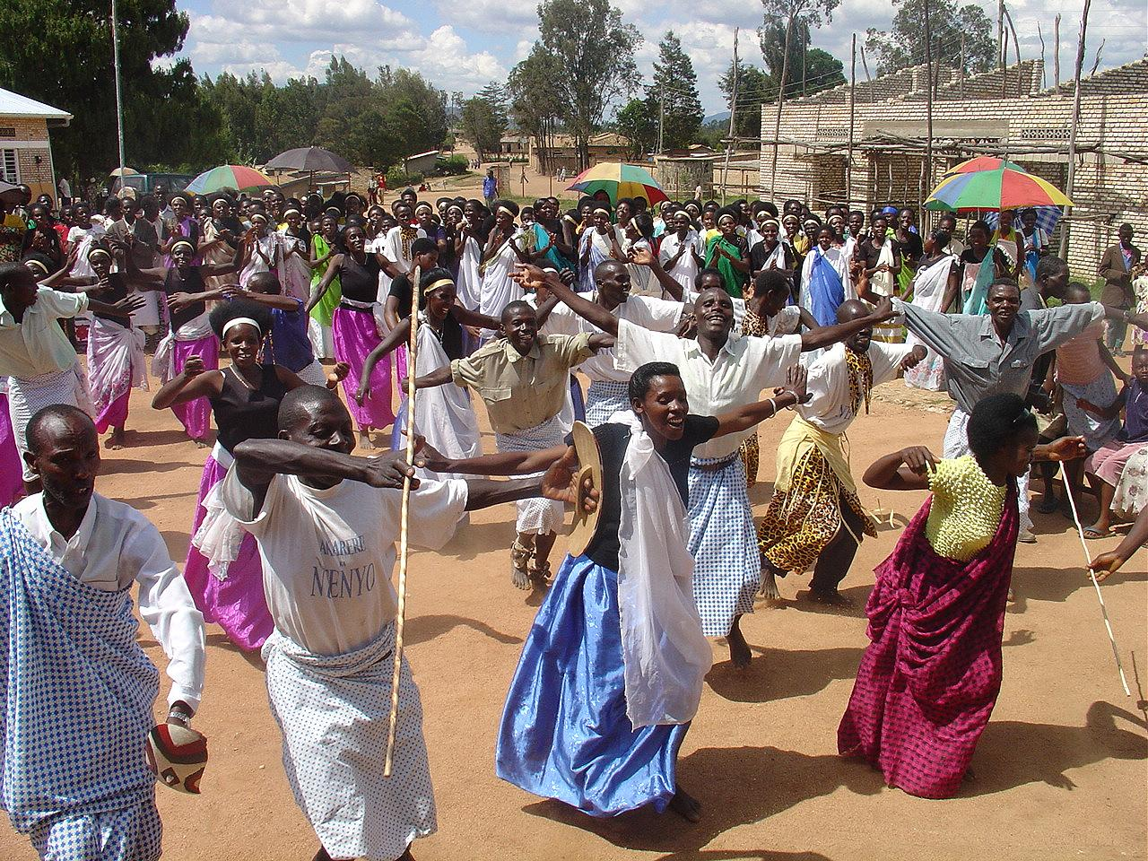
Celebrating peace, unity and reconciliation

